Slide 1

Inn management system
Review :2

Slide 2
Introduction to review 2
Inn management
system
(mini project) Algorithm
01
Inn management
Block diagram
02
Design
implementation of program
And result
03

Slide 3
1. Algorithm for Inn management system (Mini project)
Step 1: start
Step 2: print the introduction of inn
Step 3: declaration of goto function by the name intro:
Step 4: input by user to his choice customer and employee by 1 and 2 numerical
Step 5: if input is 2 or user is 2
Step 6: calling function opens employlogin () {(control transfer to called function)}
Step7: if input is 1 or user is 1 customer blog opens
Step8: input customer name
Step9: input mobile number

Slide 4
Step10: input id card type
Step11: input id number
Step12: input user choice lodging or dinning (1 or2)
Step13: control switches to case 1 if input is 1 in choice( lodging)------------algorithm 2
Step14: control switches to case 2 if input is2 in choice (dinning)
Step15: goto intro
Step16: end

Slide 5
Algorithm 2:
(Starts after the input 1 in user choice called lodging)
Step1: start
Step2: control transfer to case 1
Step3: input type of room user choice 1 or 2
Step 4: input type of room condition user choice 1 or 2
Step5: input number of rooms
Step6: input user choice (dinning or lodging) 1 or 2
Step7: if food is 1 or dining is user choice
Step8: input type of food 1or 2
Step9: input user choice size 1 or 2
Step10: input members dine

Slide 6
Employlogin ():
Step1: start
Step 2: input name of employee
Step3: input password
Step4: if password is 9999
Step5: input edited prices of customer choices
Step6: else password is rather than 9999
Step7: output “login failed wrong password”
Step8: control transfer to main function starts from where the control transferred to subfunction
Step9: end

Slide 7
Bill ():
Step1: output of introduction of bill function
Step2: output customer name
Step3: output mobile number
Step4: output of amount customer should pay
Step5: output welcome details
Step6: control transfer to main function starts from where the control transferred to subfunction
Step7: End

Slide 8
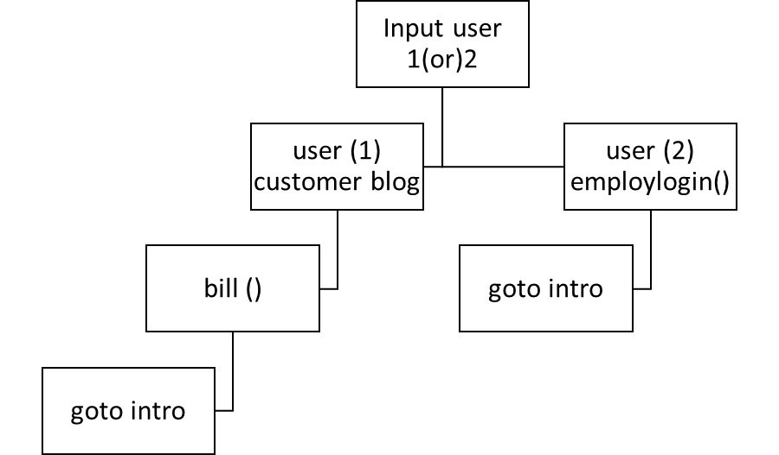
Block diagram for inn management system

Slide 9
Customer blog
user ==1
input
customer name
mobile number,id number etc
input(1) lodging or (2)dining
type=1 input user lodgingselections
type==2 input user dining selections
bill ()
goto intro
bill ()
goto intro

Slide 10
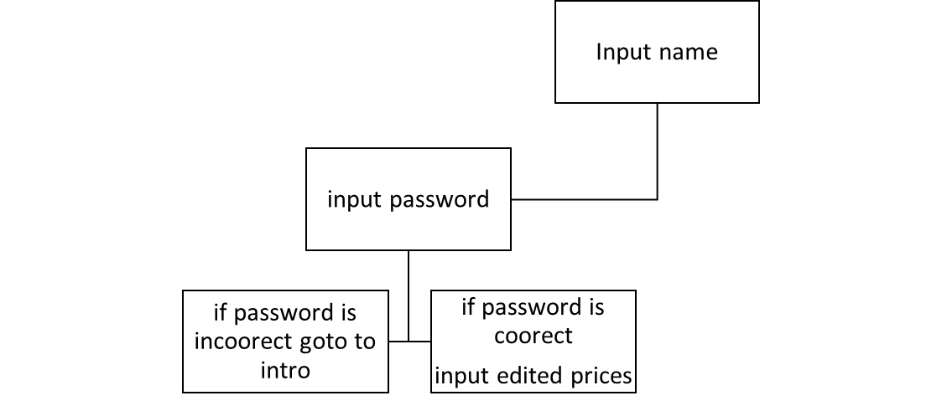
Employlogin()
Bill ( )
Output bill details
contact number
amount
to be paid
greetings

Slide 11


Slide 12
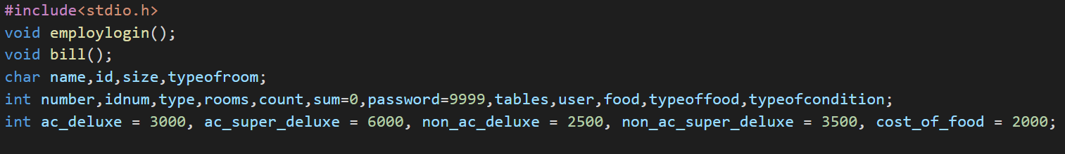

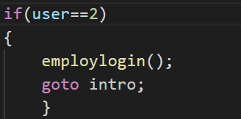
Declaration of global variables and sub functions related to rates and type of rooms and type of food etc.
“Intro” is the label for goto statement if the goto statement added to function then the control transfer to intro
From the user input program splits into two categories one is customer and employee
By input 1 and 2 here conditional statements shift the control to user type

Slide 13
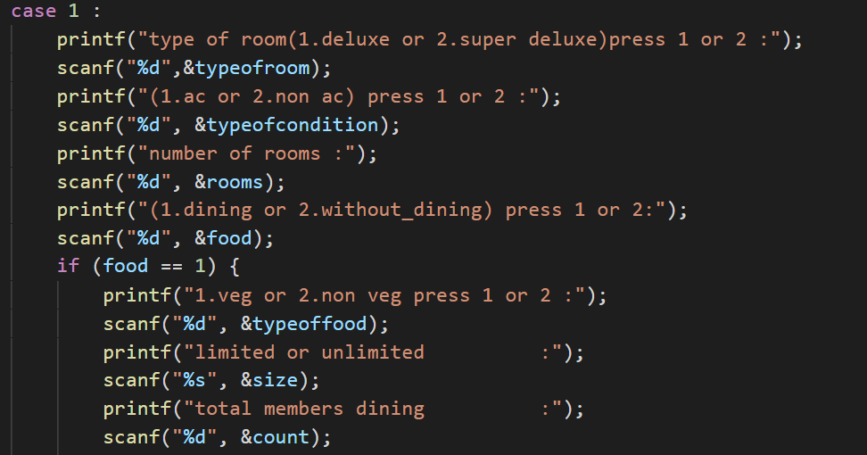
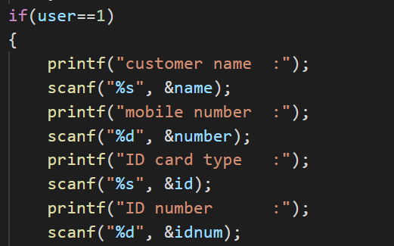
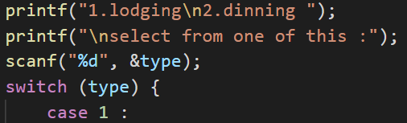
→(The if statement allows you to control if a program enters a section of code or not based on whether a given condition is true or false. ... One of the important functions of the if statement is that it allows the program to select an action based upon the user's input.)
→(Each value is called a case, and the variable being switched on is checked for each switch case.)
→(A switch statement is a conditional statement used in C programming to check the value of a variable and compare it with all the cases.)

Slide 14
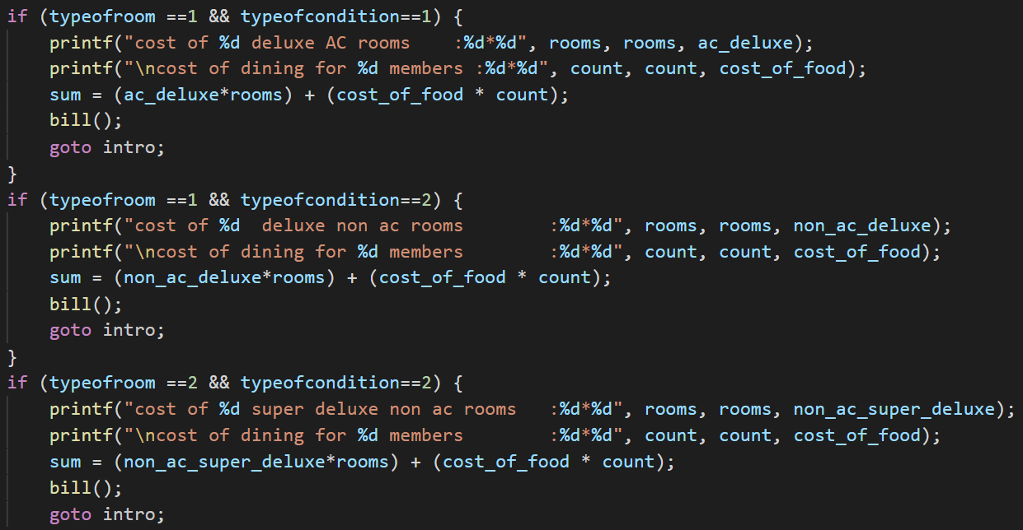
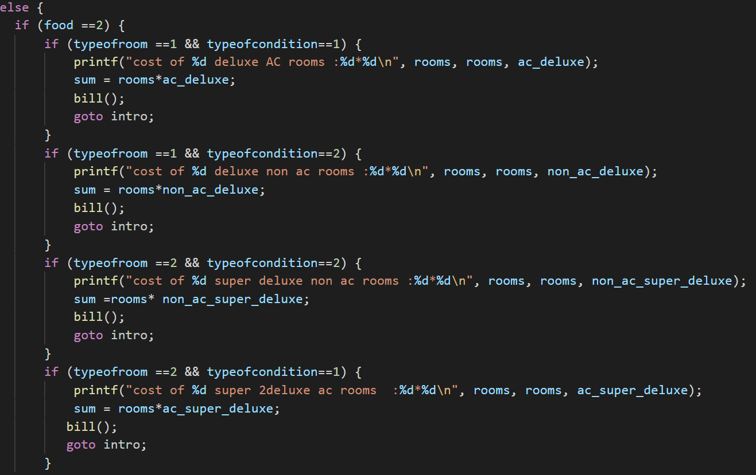
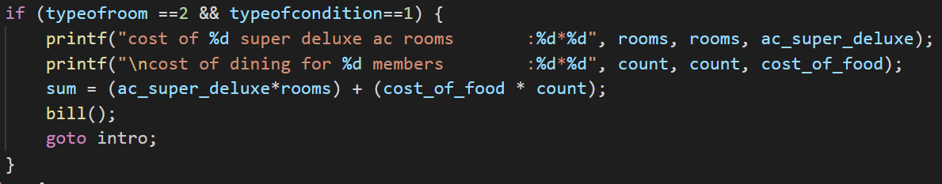
→(In switch case 1 this includes price for selected choice like each conditional statements consists of different combinations of customer selections of dining and lodging )
→(Else conditional statements consists of nested if to give combinations of prices of user selection of only lodging)

Slide 15
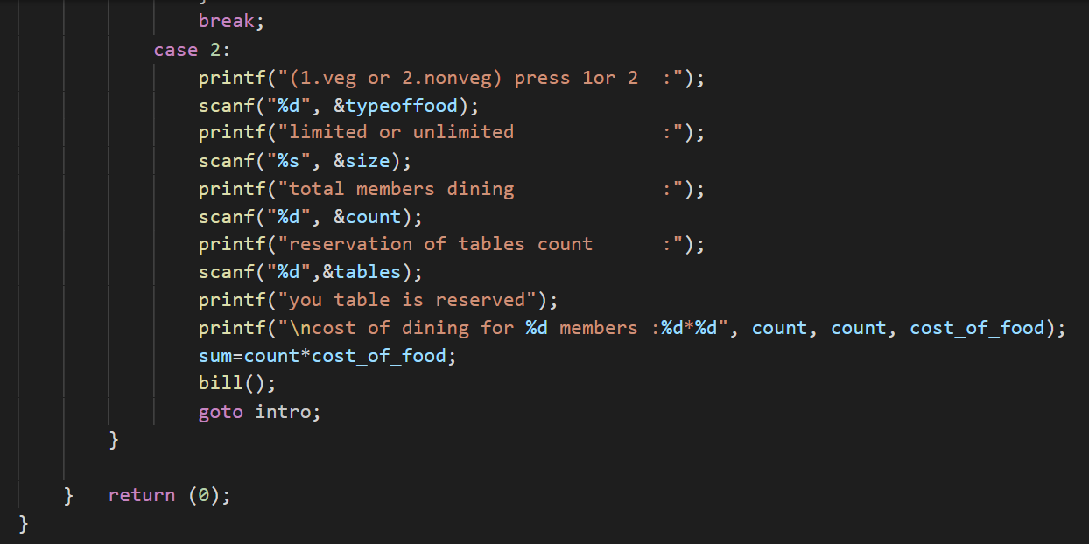
→(in this module switch case 2 consists of customer input related to only dining facility here, the prices even be displayed in bill subfunctions. )

Slide 16
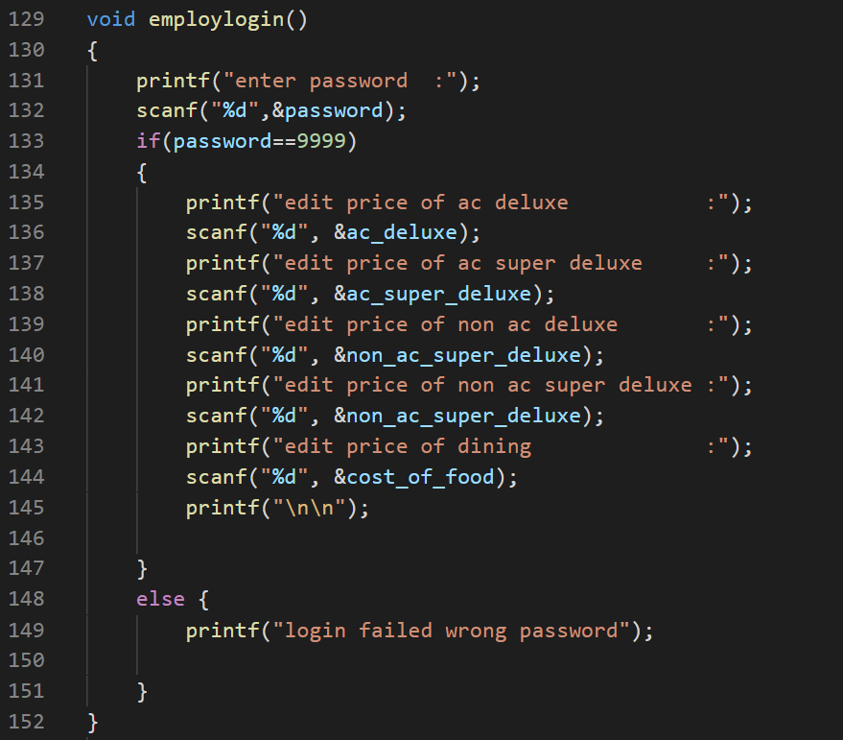
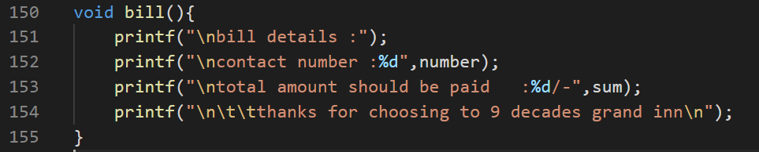
→(Here employlogin () is subfunction consists of user input related rate fixation of different categories of customer selection)
→(here bill () is totally a output subfunction which consists of bill details like amount to be paid. The function is used in all conditional statements and even in swich cases it’s a important function in this project .)

Slide 17
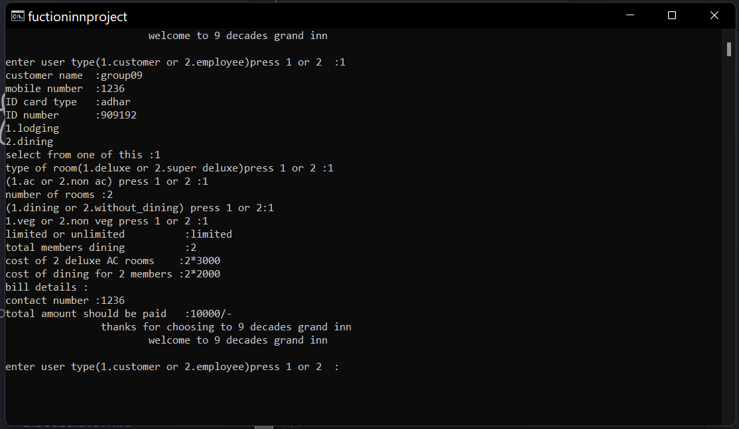
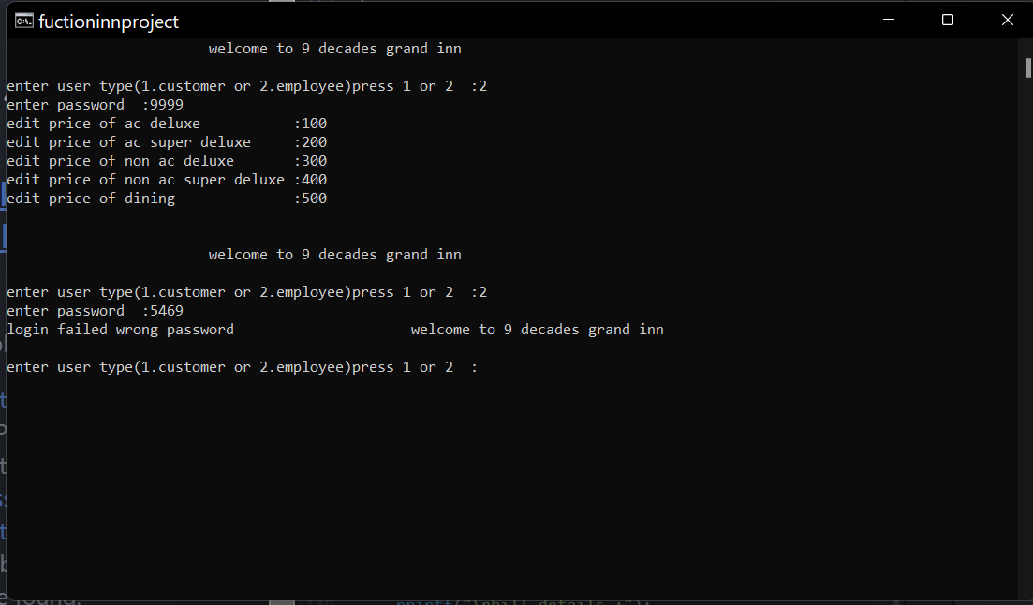
RESULTS FOR VARIOUS INPUTS BY USER
When user ==1 (customer selecting both dining and lodging )
When user==2 (employee ) user editing the prizes

Slide 18
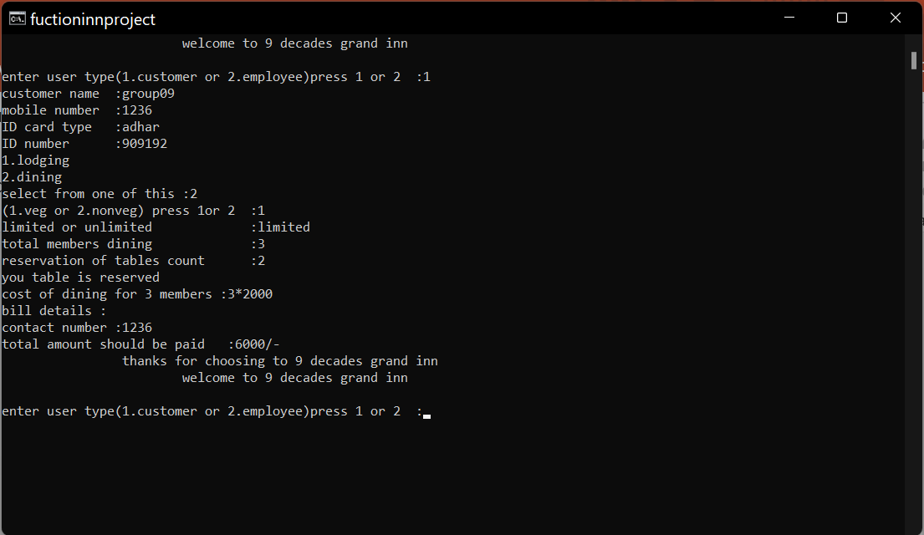
When user==1 (customer) selected dining

Slide 19
Design implementation is done in atom and vscode
Thank you

